Slide 1

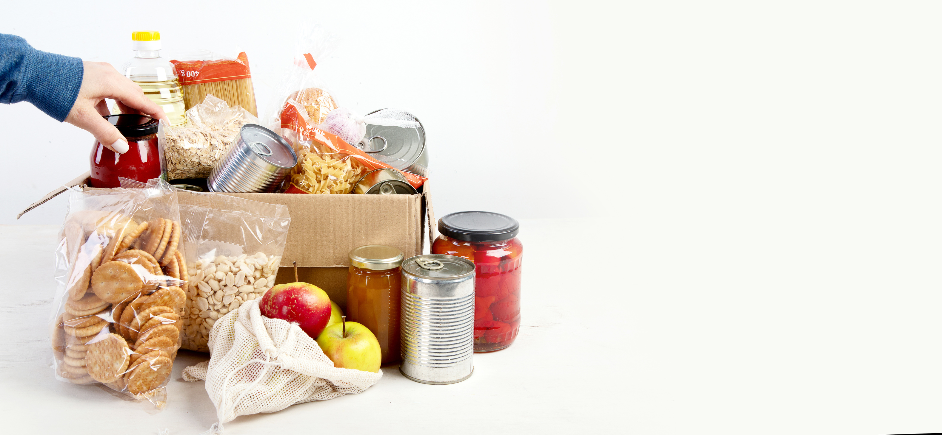



FOOD RESCUE APP
Arnav Bhatia 1024030420 abhatia4_be24@thapar.edu
Kush Saharan 1024240096 ksaharan_be24@thapar.edu
Manan Dubla 1024030186 mdubla_be24@thapar.edu

Slide 2


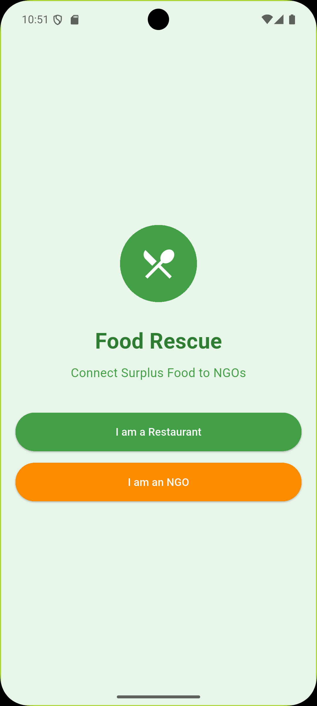
PROJECT OVERVIEW
The Food Rescue Mobile App aims to connect surplus food with communities in need, tackling food waste while addressing food insecurity and creating a positive impact.
OBJECTIVES
GOALS
Reduce food waste significantly
Support local communities in need
Create a sustainable donation platform
Engage local restaurants and stores
Achieve 500+ monthly listings
Ensure a seamless user experience

Slide 3



FOOD WASTE CRISIS
1.3 billion tons of food is wasted annually.
Locally, 30-40% of supply is wasted.
This results in $1 trillion lost and significant emissions.
828 million people face food insecurity today.

Slide 4


TARGET USERS
MARKET OVERVIEW
Restaurants can donate excess food
Users include various stakeholders
Grocery stores seek to reduce waste
Focus on urban communities
NGOs connect with food-insecure individuals
$46B market potential exists

Slide 5


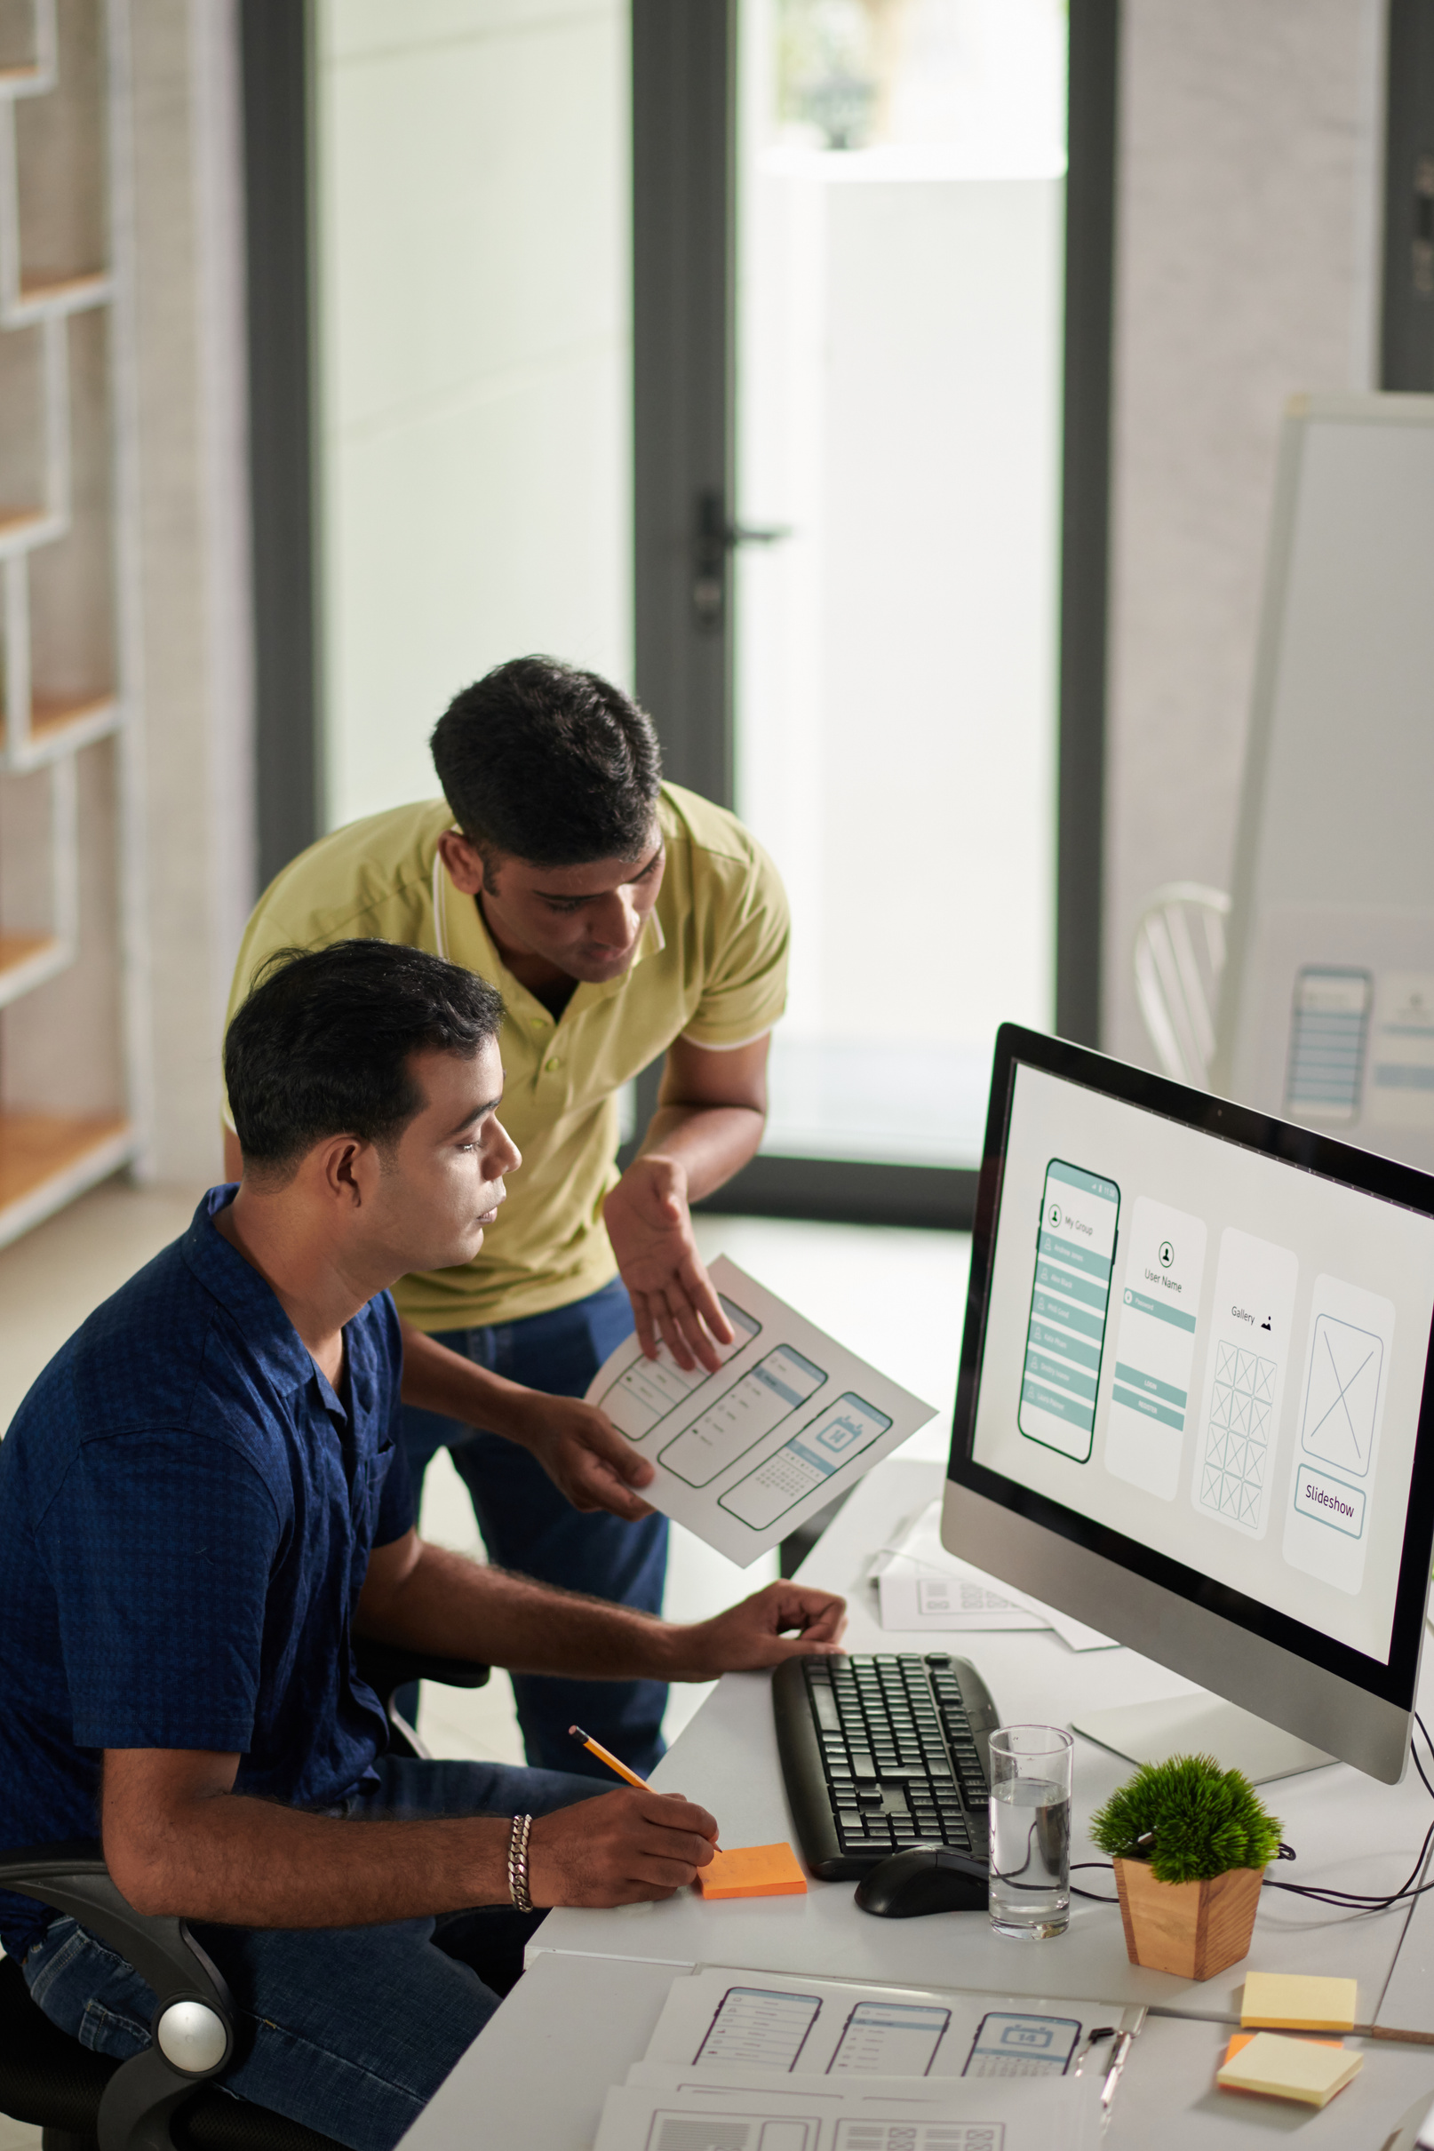


OUR SOLUTION
A real-time donation platform connecting surplus food with those in need, securely and efficiently.

Slide 6



CORE FEATURES OF THE APP
User Authentication
Role-Based Access
Food Listing
Secure access for users
Different access levels
Dynamic food inventory
Ensures only registered users can access the app's features and functionalities.
Donors, recipients, and admins have specific permissions to manage their interactions.
Users can easily list available food items for donation and track their status.

Slide 7
USER FLOWS OVERVIEW
Donor Flow
Recipient Flow
Easy donation process
Seamless food retrieval
Donors can quickly list and donate surplus food via the app.
Recipients can easily claim available food and communicate with donors.

Slide 8
TECHNICAL ARCHITECTURE
Frontend Framework
Backend Services
Database Management
Security Measures
PHP REST API
JWT for authentication
Flutter for cross-platform
Handling data requests and responses
MySQL for storage
Efficient data organization and querying
Ensuring safe user access and data
Developing a seamless user experience

Slide 9
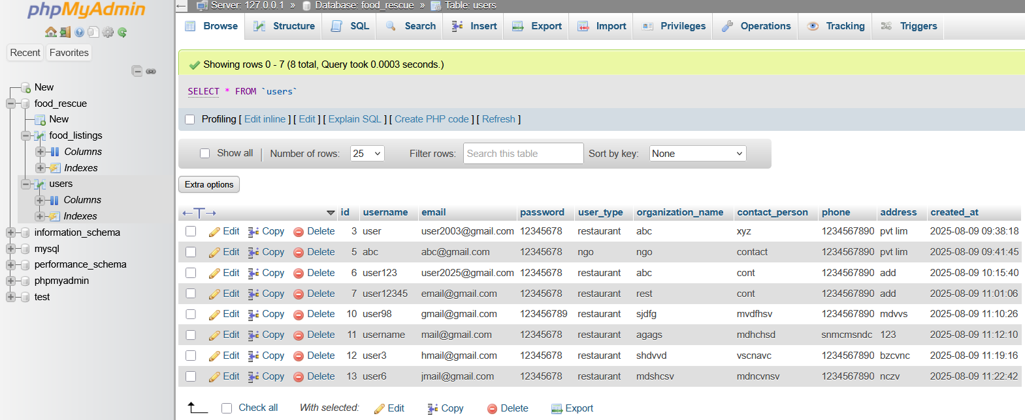
DATABASE DESIGN OVERVIEW
Heading | Heading | Heading | Heading | Heading

Slide 10
FLUTTER PROJECT STRUCTURE OVERVIEW
State Management
User Interface
Routing
Managing app state effectively
Building a responsive UI
Navigating between app screens
Leverage Flutter widgets to create intuitive and engaging designs.
Utilize Provider or Bloc for efficient state handling.
Implement Navigator for seamless transitions and deep linking functionalities.

Slide 11

API ENDPOINTS OVERVIEW
Authentication
Secure user login and access management.
Food Management
Handle food listings and updates efficiently.
User Interaction
Manage user profiles and communication channels.
Analytics Tracking
Monitor app performance and user engagement metrics.

Slide 12




63%
87%
API Client Usage
Location Tracking Success
63% of users actively use the API client for seamless integration.
87% accuracy in location tracking enhances the user experience significantly.

Slide 13


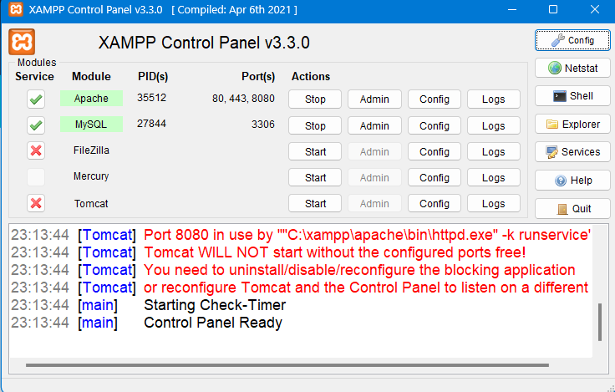
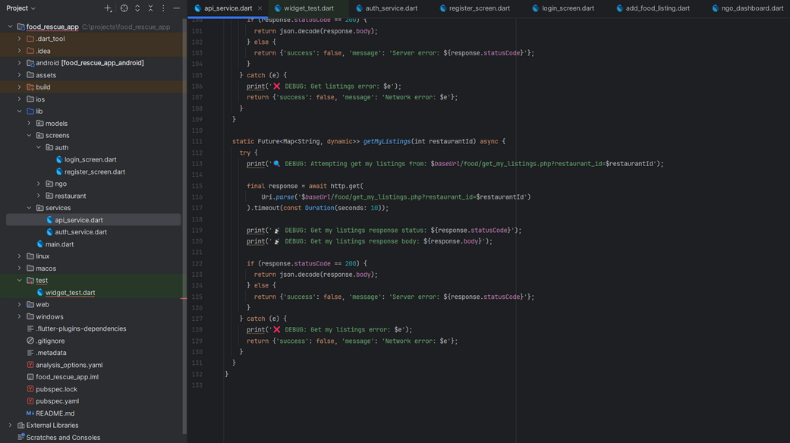


DEVELOPMENT SETUP TIMELINE
XAMPP Installation Complete
Android Studio Setup
Configured Android Studio for Flutter development, establishing a robust development environment.
Successfully installed XAMPP, enabling local server and database management for the project.

Slide 14
SECURITY MEASURES TIMELINE
Password Encryption
Role Access
HTTPS Implementation
Established clear role-based access controls to limit user permissions effectively.
Implemented strong encryption for user passwords to enhance data security.
Transitioned to HTTPS for secure communications, ensuring data integrity and privacy.

Slide 15
REAL-TIME SYNC TIMELINE
Event Updates
Conflict Resolution
Offline Consistency
Performance Optimization
Implemented system for instant notifications of food donations and requests.
Developed protocols to handle discrepancies during food matching for users.
Achieved seamless functionality during intermittent connectivity for user experience.
Enhanced real-time operations to ensure minimal latency and increased reliability.

Slide 16
TESTING MILESTONES
Initial Unit Testing
Integration Testing
Acceptance Testing
Load Testing
Security Testing
Evaluated app performance under high traffic to identify bottlenecks.
Conducted unit tests to verify individual components and their functionality.
Assessed interaction between different modules to ensure seamless integration.
Engaged end-users to validate the app meets project requirements and expectations.
Performed security assessments to ensure data protection and vulnerability mitigation.

Slide 17
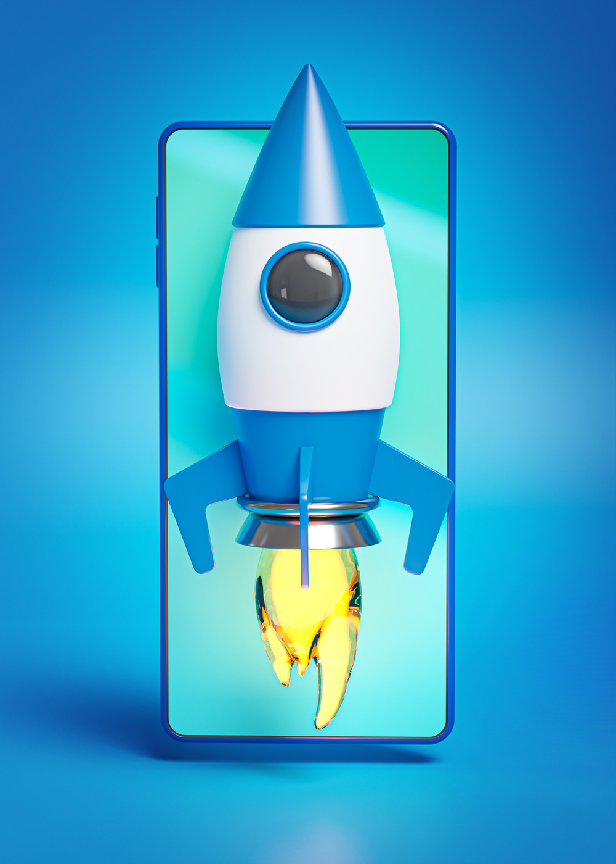



PERFORMANCE METRICS OVERVIEW
API Response Times
Launch Speed
The API responds in under 200 milliseconds.
The app launches in less than 3 seconds.

Slide 18

IMPACT OF FOOD RESCUE APP
Discover how our app transforms food surplus into community resources effectively.
500+ listings per month help connect surplus food to those in need.
Over 2 tons of food saved annually, reducing waste significantly.
150+ active users engage with the app regularly, fostering community involvement.
Provides real-time updates to ensure efficient food donations and pickups.
Promotes sustainable practices and reduces greenhouse gas emissions from food waste.

Slide 19
THANK YOU!

